Slide 1

Spring Hello World Example
Technologies used in this example :
Spring 5.0.2.RELEASE
Maven 3.5.2
Eclipse OXYGEN
JDK 1.8.0_73

Slide 2
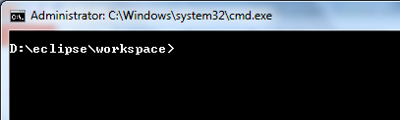
Spring Hello World Example
Step 1: Generate project structure with Maven

Slide 3
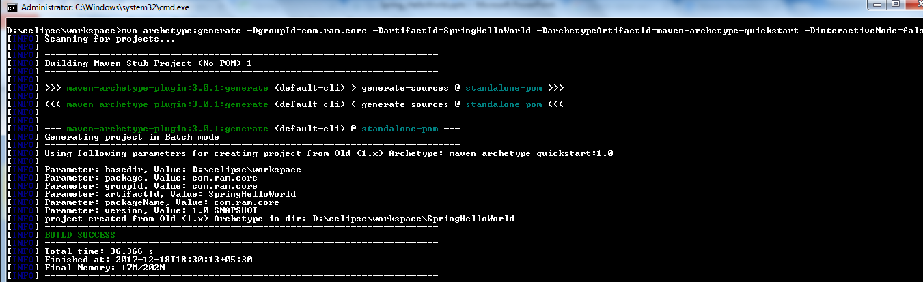
Spring Hello World Example

Slide 4
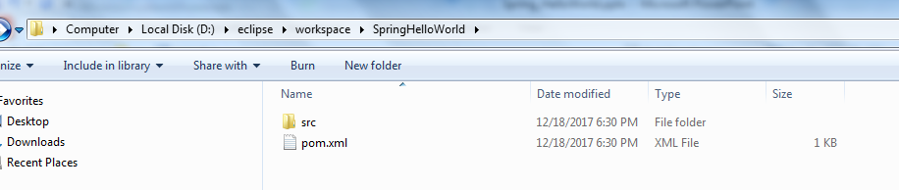
Spring Hello World Example

Slide 5
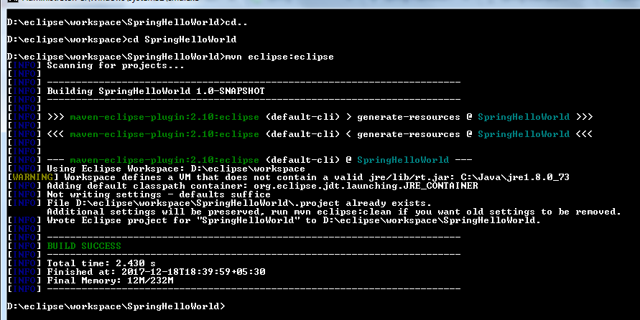
Spring Hello World Example
Step 2: Convert to Eclipse project
Convert Maven style project to Eclipse’s style project, and import into Eclipse IDE.

Slide 6
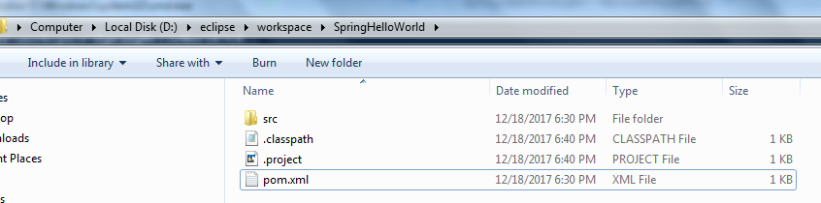
Spring Hello World Example
.classpath and .project are created

Slide 7
Spring Hello World Example
Import eclipse screen shots,Dir sturucture

Slide 8
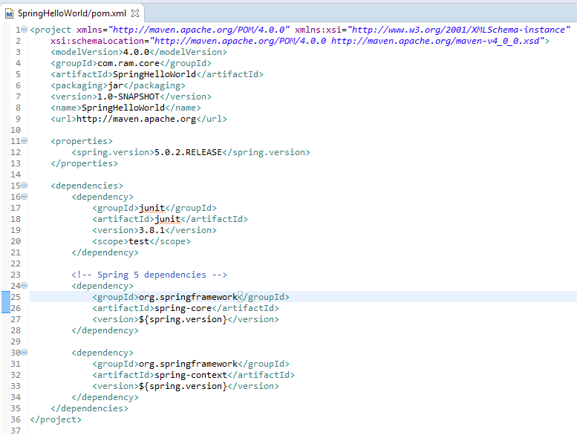
Spring Hello World Example
Step 3: Add Spring 5.0.2 dependency
Add the Spring 5.0.2 dependencies listed below in Maven’s pom.xml file.
The Spring dependencies are available for download via Maven central repository.

Slide 9
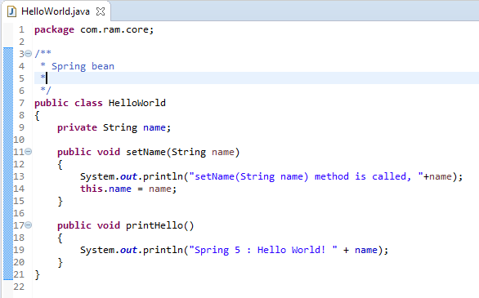
Spring Hello World Example
Step 4: Spring bean

Slide 10
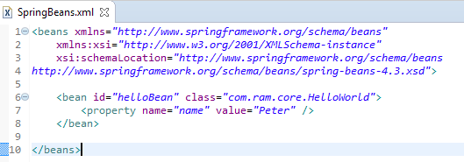
Spring Hello World Example
Step 4: Spring bean configuration file
Create a Spring configuration file, and declare all the available Spring beans.

Slide 11
Spring Hello World Example
Step 5: Review project structure

Slide 12
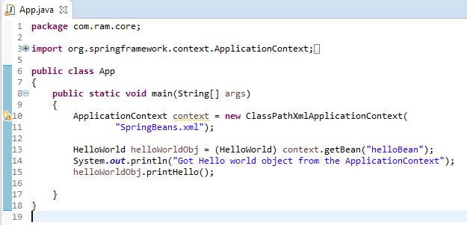
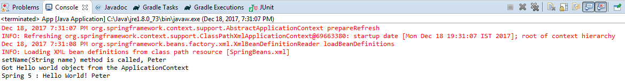
Spring Hello World Example
Step 6: Run

Slide 13
Spring Hello World Example

